Slide 1

Microsoft Diving Into the Movie Scene
Descriptive analysis of recent movie industry trends
by
Dorothy Alexander, John Carter Simmons, and Pete VanZandt

Slide 2

Summary
A balance of risks and rewards considers:
A mixture of moderate and large budget productions
Genres that match budget recommendations
Release dates that maximize success
Mars Needs Moms: the biggest loser in the film industry, losing over $100m

Slide 3
Outline
Business Problem
Data & Methods
Results
Recommendations

Slide 4

Business Problem
The movie industry is complex, crowded, and risky with no guarantees.
How can Microsoft maximize its chance of success?

Slide 5


Data and Methods
Data sources included:
The Internet Movie Database (IMDB)
The Numbers database (TN)
From there we focused on two main metrics for success:
Net profit (total gross – production costs)
Return on investment (net profit / production costs)
Focused on recent trends (2010-2019)

Slide 6
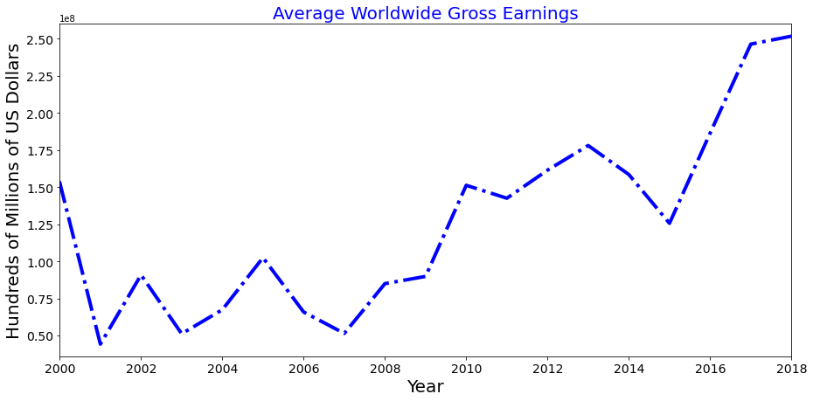
It’s a good time to be in the movie business
Worldwide, box office ticket sales are going up

Slide 7
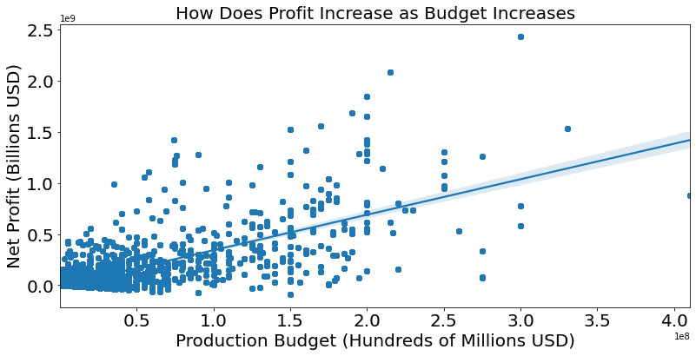
More costly movies tend to make more profit
Bigger is better?
Bigger budget films yield bigger returns
…but also greater risk

Slide 8
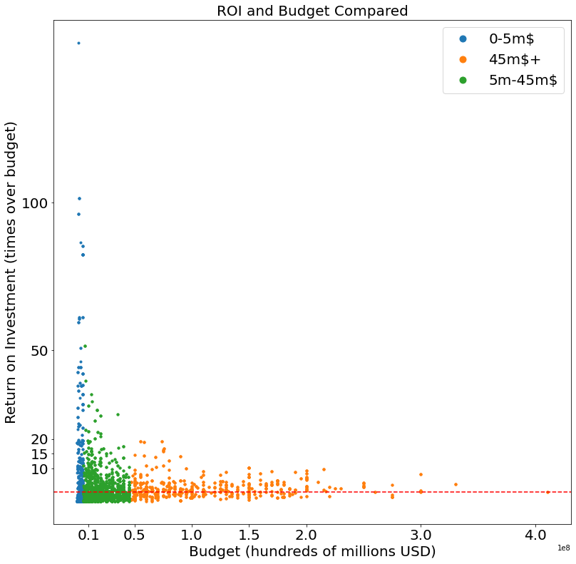
Three kinds of movie budgets
Small budget: few with high ROI
Small budget: less than $5m (25%)
Moderate budget: $5m - $45m (50%)
Large budget: $45m and above (25%)
Moderate budget
Large budget
ROI = 2 (profit = all costs)

Slide 9
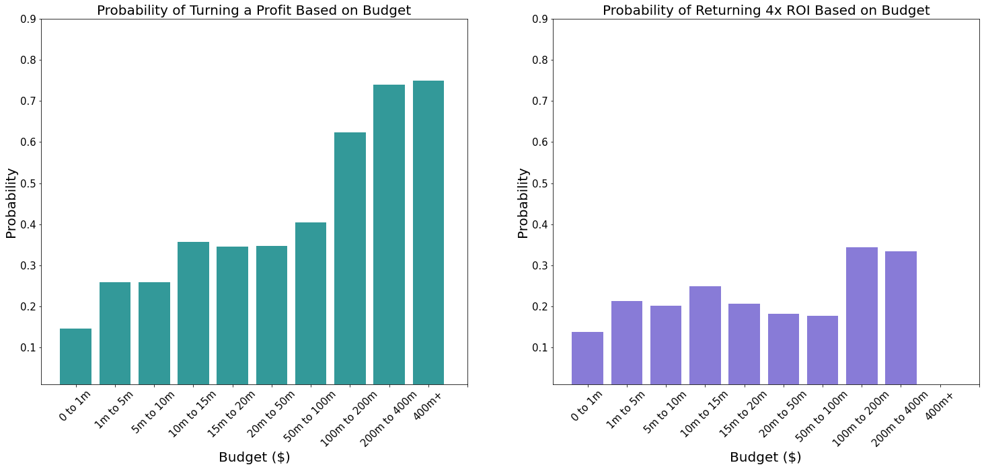
The likelihood of high ROI varies depending on investment
Large budget films have a better chance of recouping costs
Overall success rates are much lower as ROI expectations rise

Slide 10
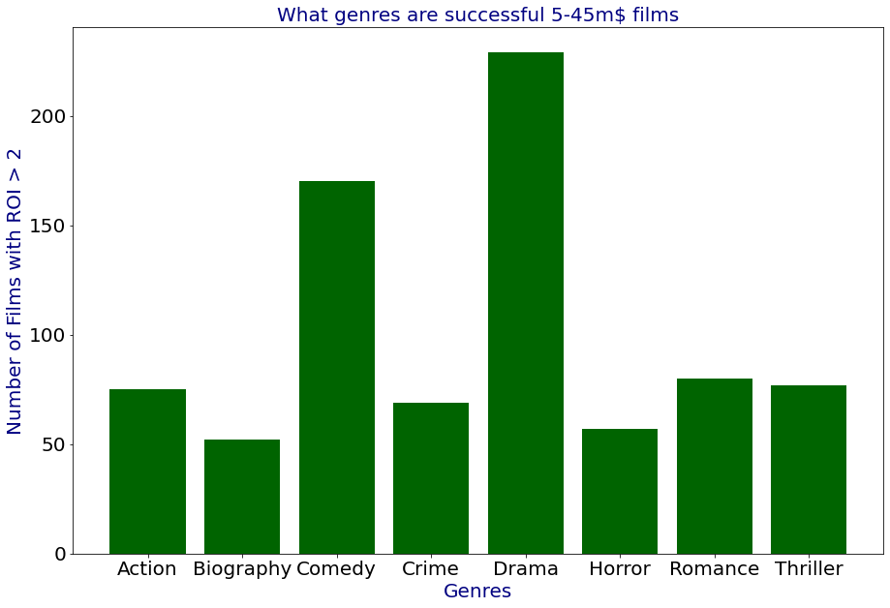
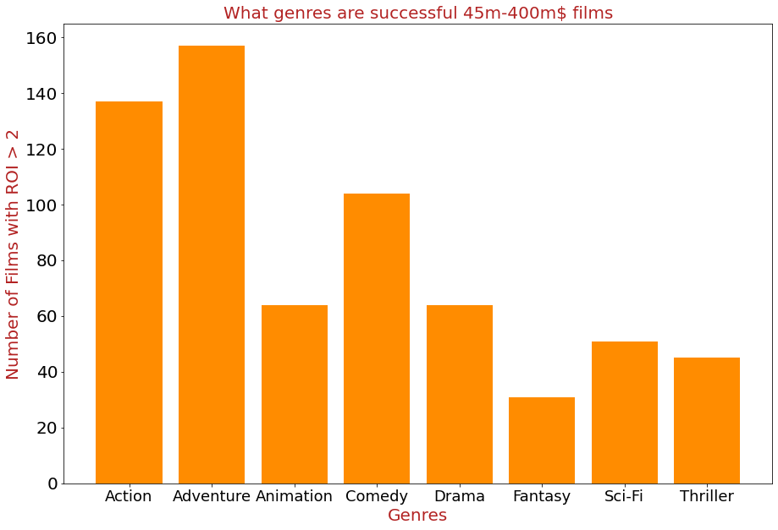
Budget influences which genres are more successful
Pick these high budget genres
Pick these mid- budget genres

Slide 11
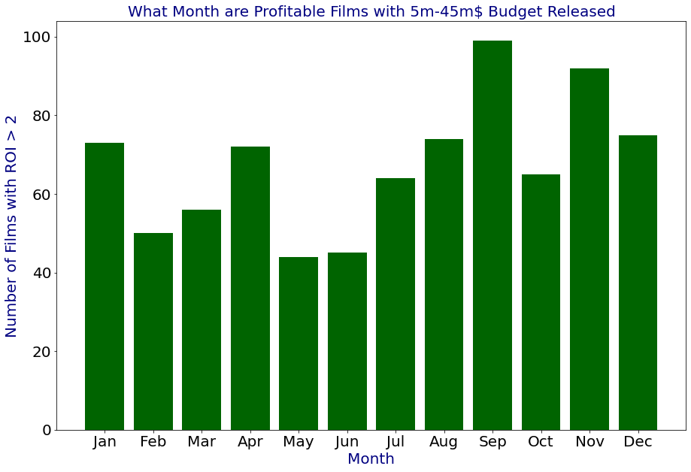
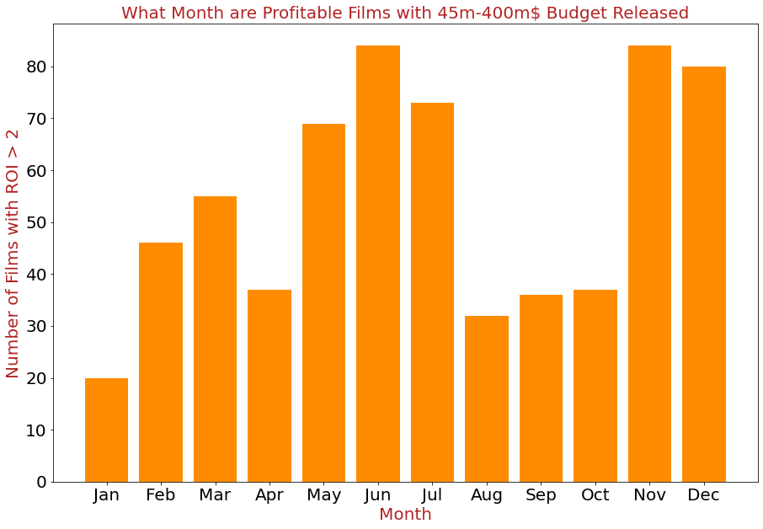
Budget influences release timing
Release large budget films in the summer or winter
Release mid- budget films in the fall - winter

Slide 12
Conclusions
There are two routes that yield high chances for success:
Produce films with a moderate budget of $5-45 million
These should focus on drama or comedy and avoid summer release dates
Produce films with a large budget of $45-400 million
These should focus on action / adventure released during summer or winter

Slide 13
Next Steps
Further analysis that could help Microsoft:
look at what trend the streaming market is, Microsoft may have an easier transition into creating a streaming service instead of going into the movie theaters

Slide 14
Appendix – keep in reserve

Slide 15
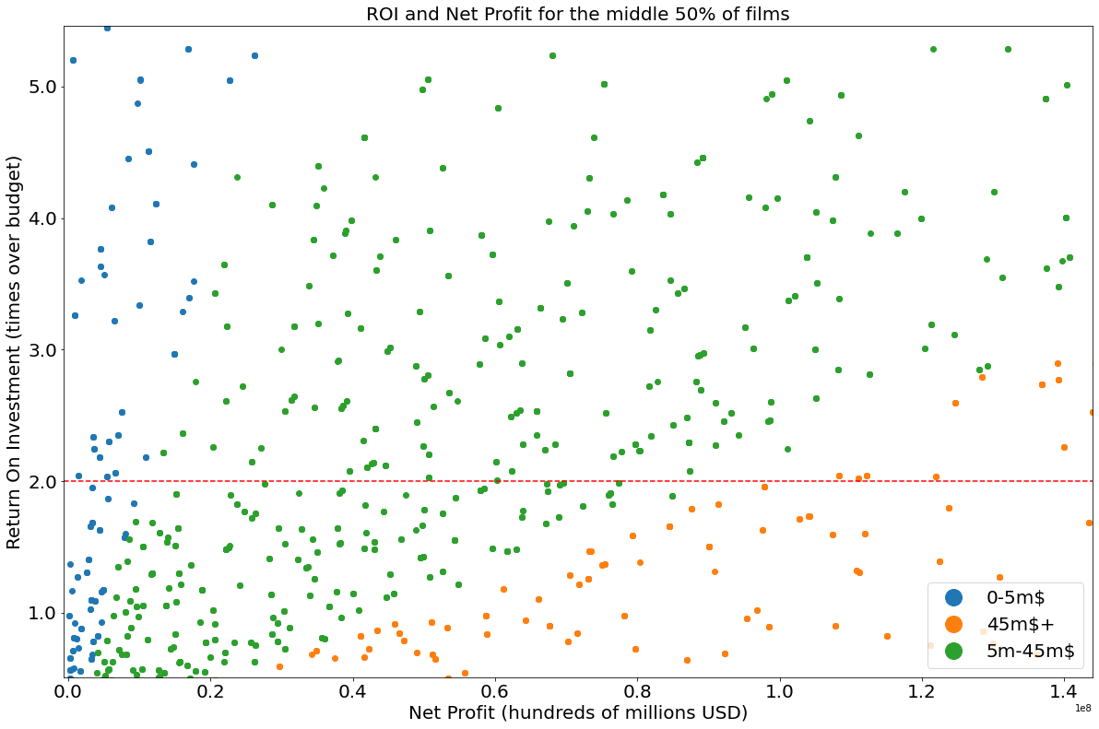
Of average films, the most successful have a budget from 5m to 45m dollars (green dots)

Slide 16
Methods
We used a descriptive analysis of data for the movie industry over time, with a focus on the last decade.
Our advice provides Microsoft with a guide to help make their decision on venturing into movie production.
Our recommendations focus on the budgetary investment, the genre of films, and the timing of release dates.

Slide 17
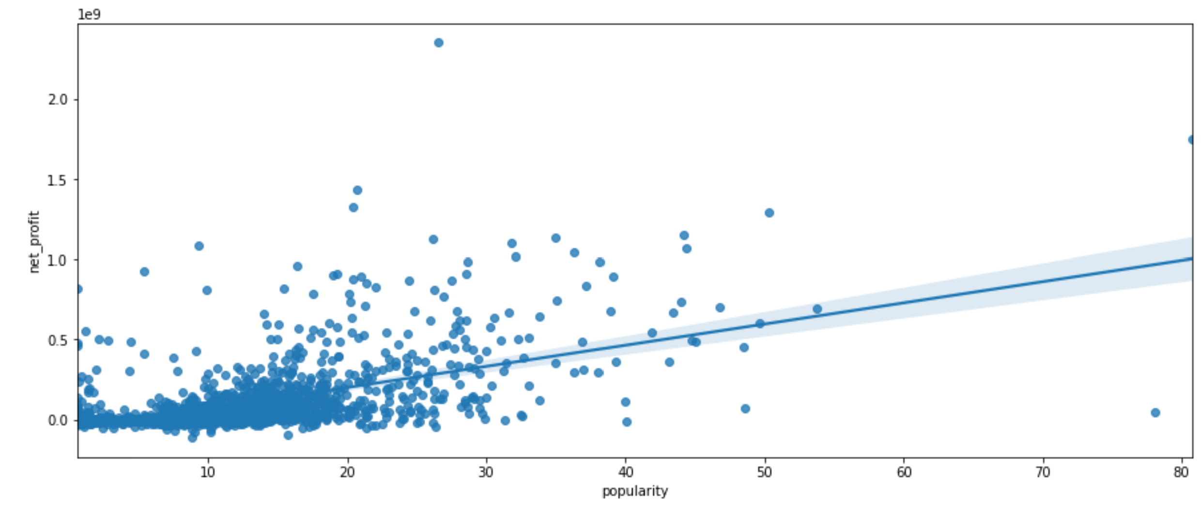
More popular movies tend to make higher profit

Slide 18
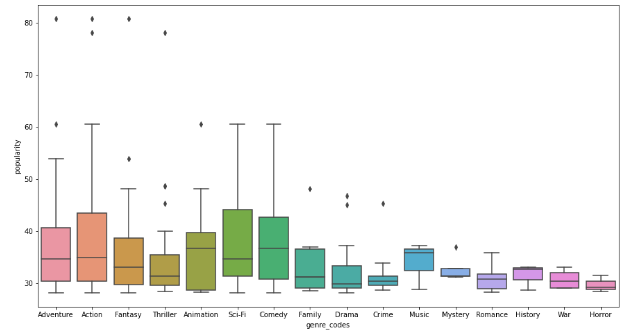
Most popular movie genres (tmdb popularity index)

Slide 19
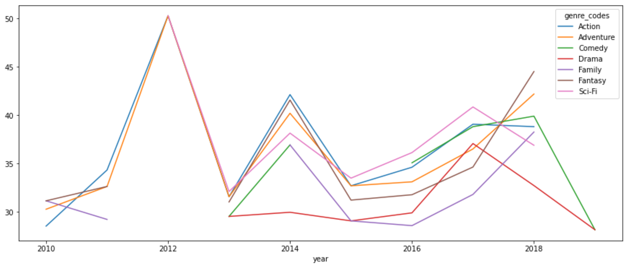
Movie popularity fluctuates over time, & aren't predictable trends

Slide 20
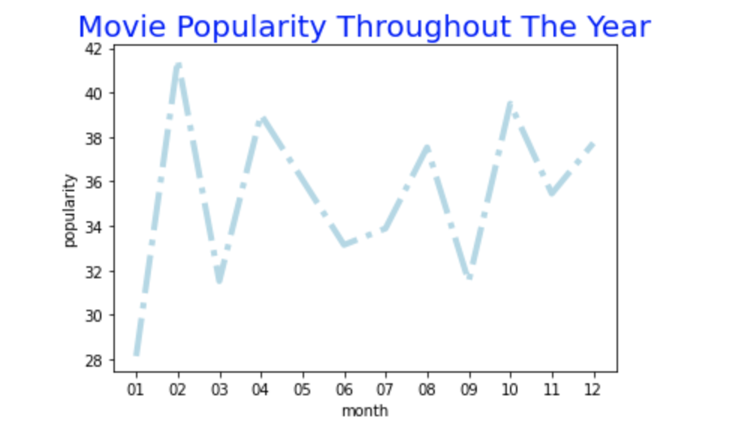
Movie popularity fluctuates across months

Slide 21
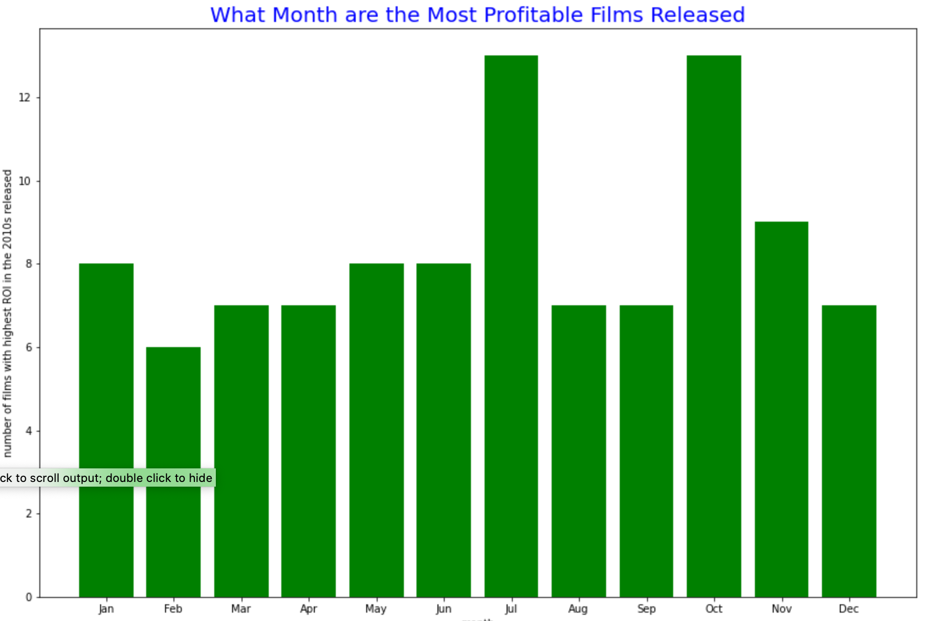
Most profitable movies are released at different months

Slide 22
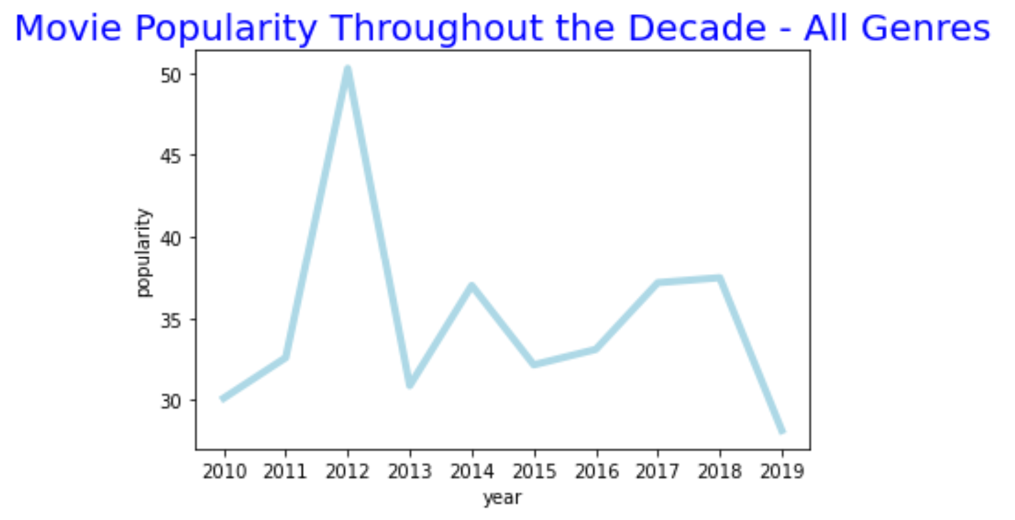
Movie popularity fluctuates over years

Slide 23

Two paths to movie profit: lottery (low budget, low chance of profit) or big budget
These are the ROI > 15 (?)

Slide 24
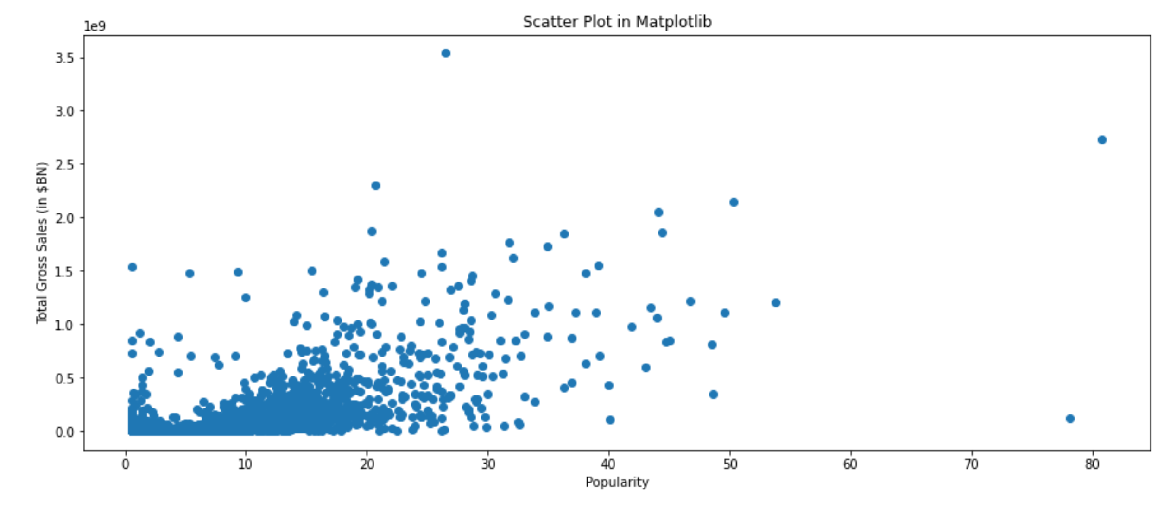
More popular movies tend to make more gross income

Slide 25
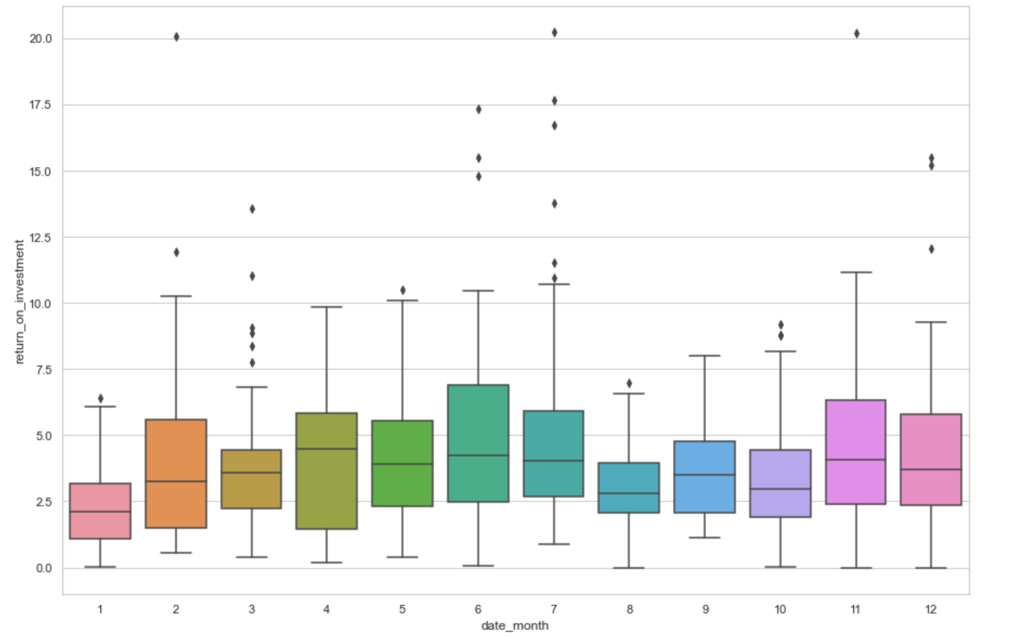

Slide 26
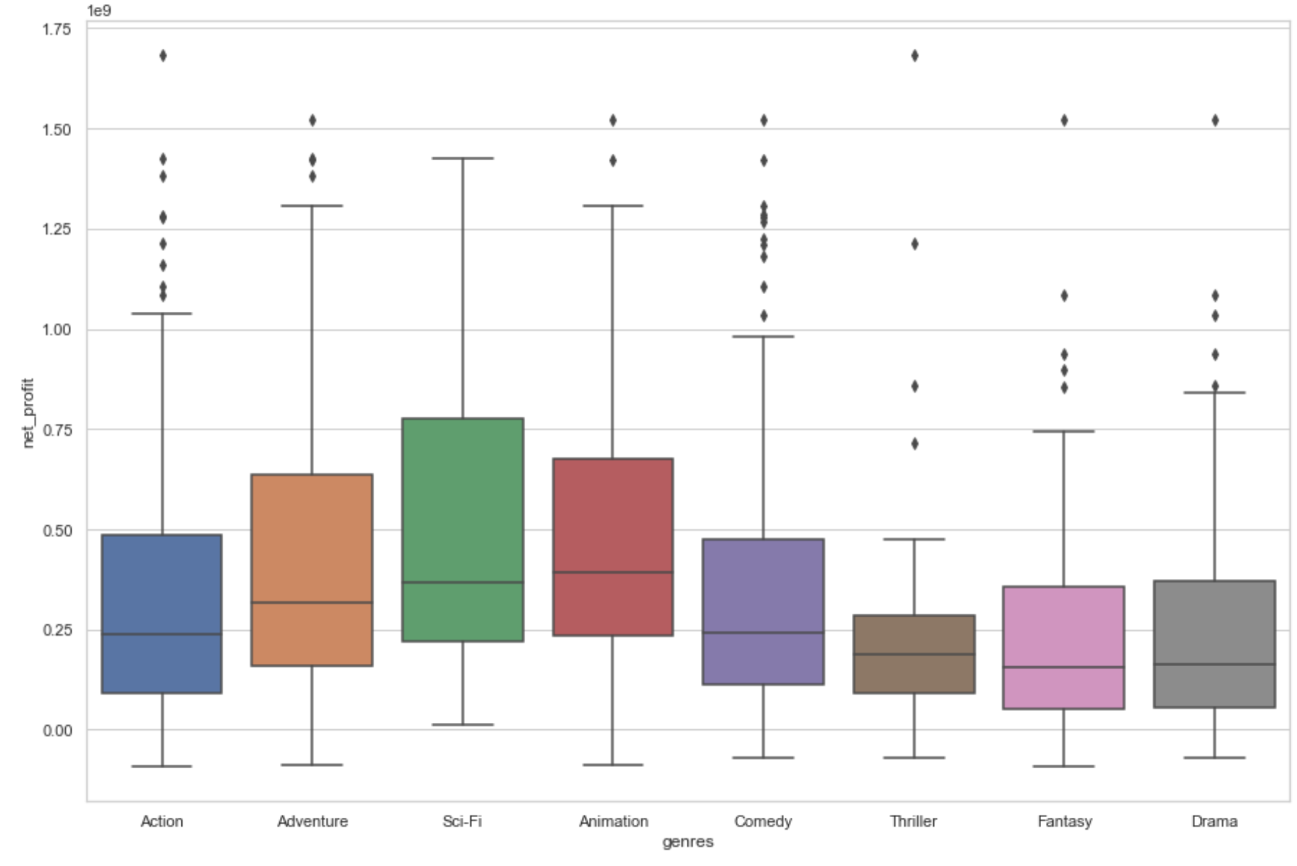

Slide 27
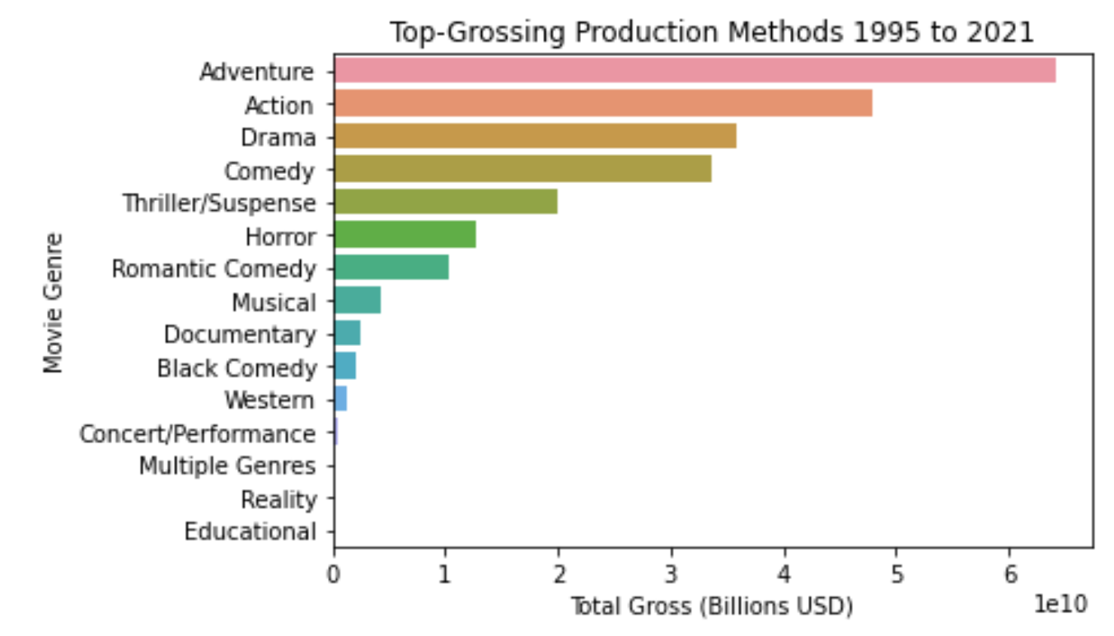
Some genres bring in more $ than others

Slide 28
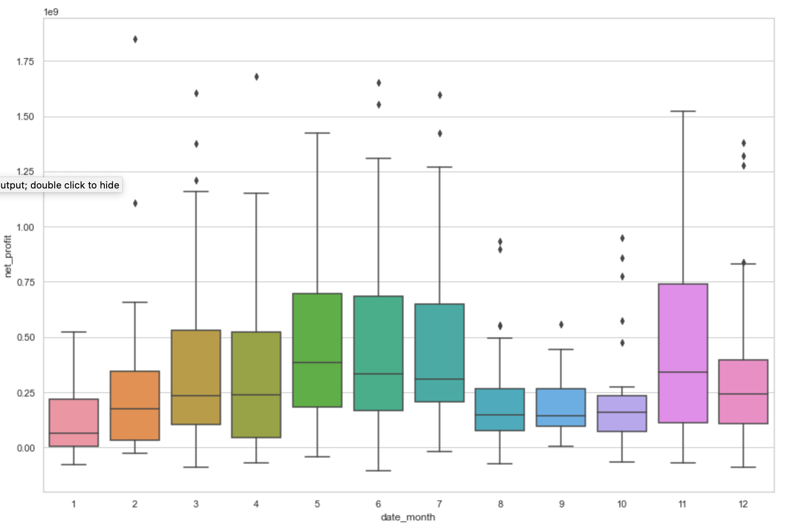
How profitable are films within our budget range when released during a given month

